Slide 1
WINS - Waves, Instabilities & Noise Spectrometer for Earth’s Ionosphere
Mentor: Naomi Yescas
Presented by Sarina Blanchard
Space Grant Symposium

Slide 2
Project Goals
My Focus
Design an instrument capable of flying on a cubest that can take electric field measurements of the ionosphere up to very high frequencies.
Measure plasma parameters and waves to the same accuracy as existing solar wind payloads.
Develop an Analog to Digital (ADC) Printed Circuit Board (PCB) to convert the input signals into digital signals.

Slide 3
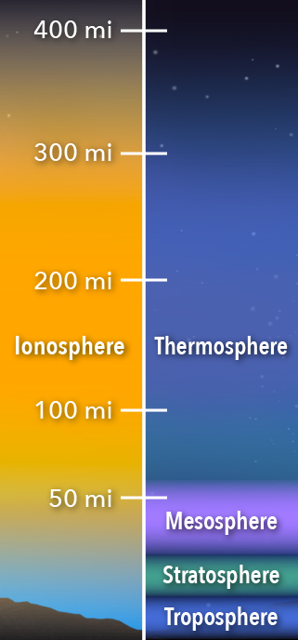
Measuring Plasma Waves in the Ionosphere
Ionosphere:
Between tens and hundreds of kilometers above Earth’s surface
Ionized by solar radiation
Phenomena:
Auroras
Tides
Plasma fountains
Credit: NASA's Goddard Space Flight Center/Mary Pat Hrybyk-Keith

Slide 4
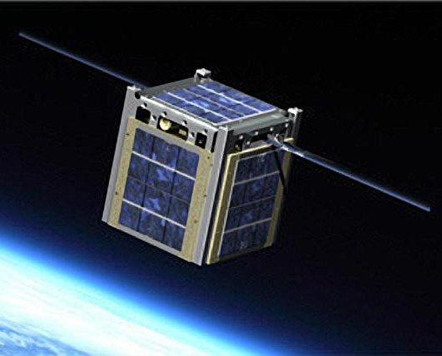
Challenges in Space
Getting enough power
Temperature variations
Noise
1U cubesat
Everything must fit in a 10 cm cube
NASA/JPL-Caltech/Montana State University
Notes:
However, running a satellite in space has numerous challenges. In space, our cubesat will be spinning around which will provide inconsistent sun exposure on the solar panels as well as causing drastic changes in temperature depending on which side of the cubesat is in the sun’s rays. There is no way to fully ground our electronics and there is noise. A mechanical challenge is fitting all our components in a cubesat.

Slide 5
PCB Concept of Operations
Connectors: Output data to FPGA
Data
Antennas
Glitch filter
ADC
Connectors
FPGA
ADC: Analog to digital converter
Data
Antennas
1.8V 3.3 V regulator
Glitch Filter: Filters out noise in the signal
Voltage regulator: Transforms 3.3 V input into 1.8 V for the ADC

Slide 6
Actual PCB
Data
Antennas
1.8V 3.3V regulator
ADC
IC Transceiver
Connectors
FPGA
Glitch filter
IC Transceiver: takes input voltage from FPGA and splits into 2 voltages, and then combines same 2 voltages back into 1
Data
Antennas
1.8V 3.3 V regulator
2 Voltage regulators: Analog and digital voltages
Notes:
IC Transceiver (low voltage differential signaling driver): converts the 3.3 V input into two opposite signals of lower voltage which is inputted into the ADC. The ADC outputs the same two opposite signals, and the IC transceiver converts them to a single higher voltage signal.

Slide 7
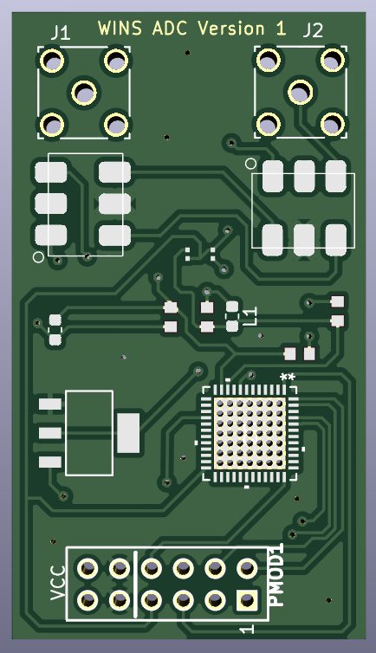
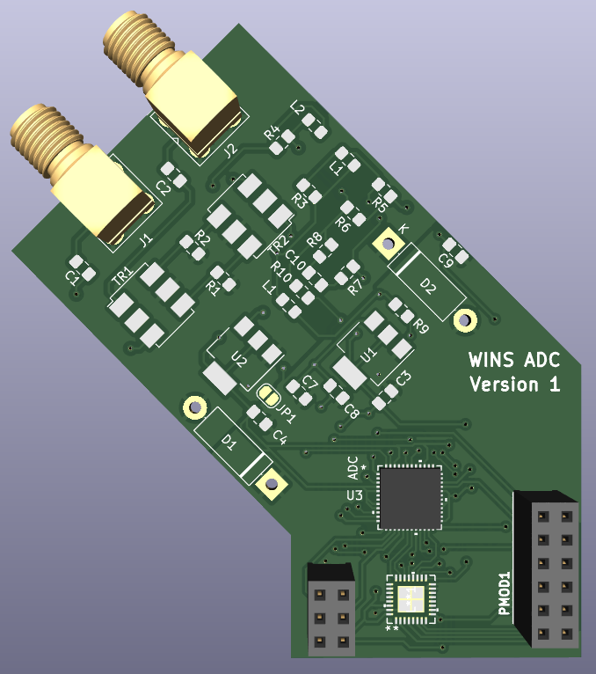
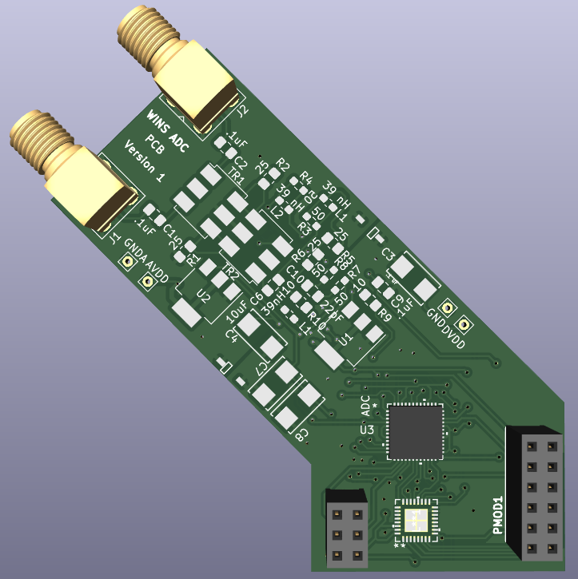
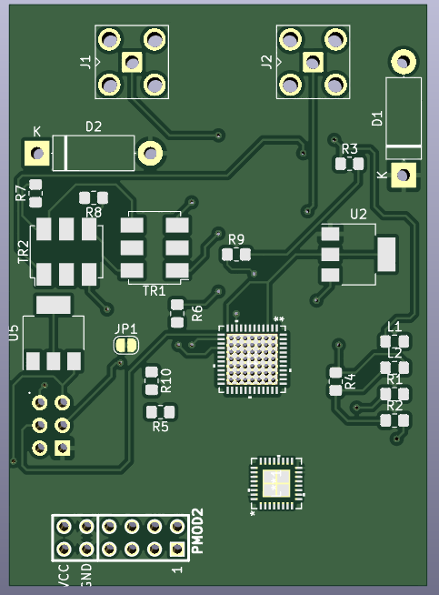
PCB Iterations

Slide 8
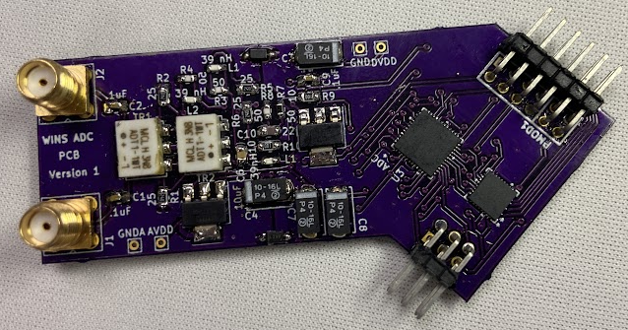
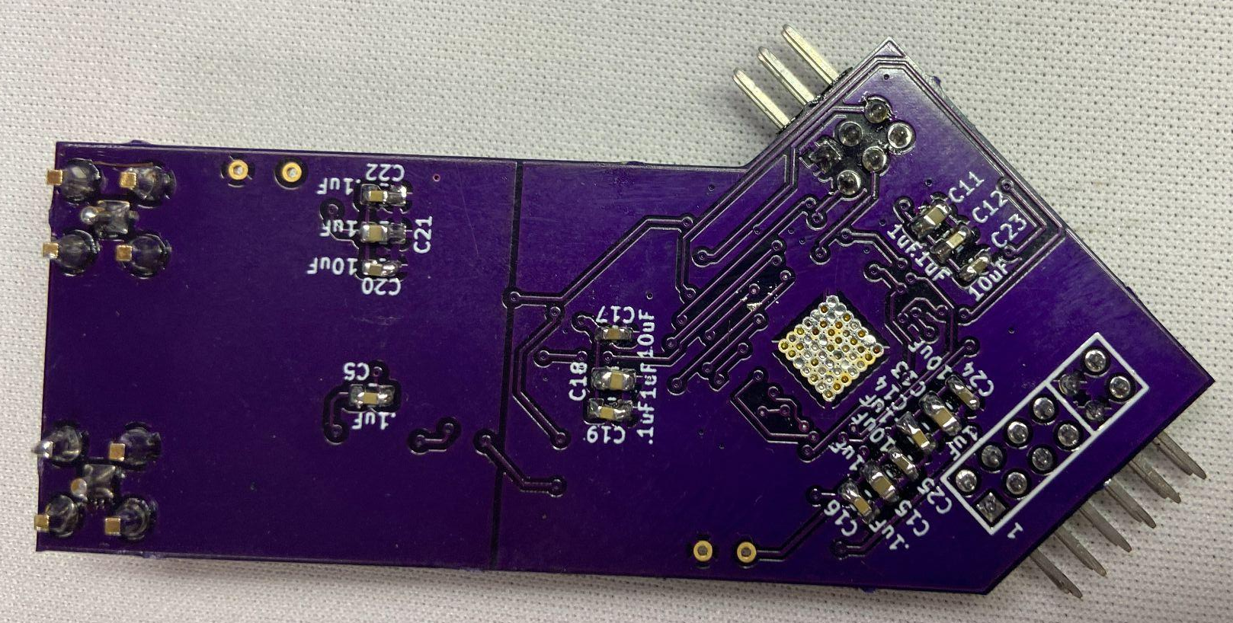
Assembled PCB

Slide 9
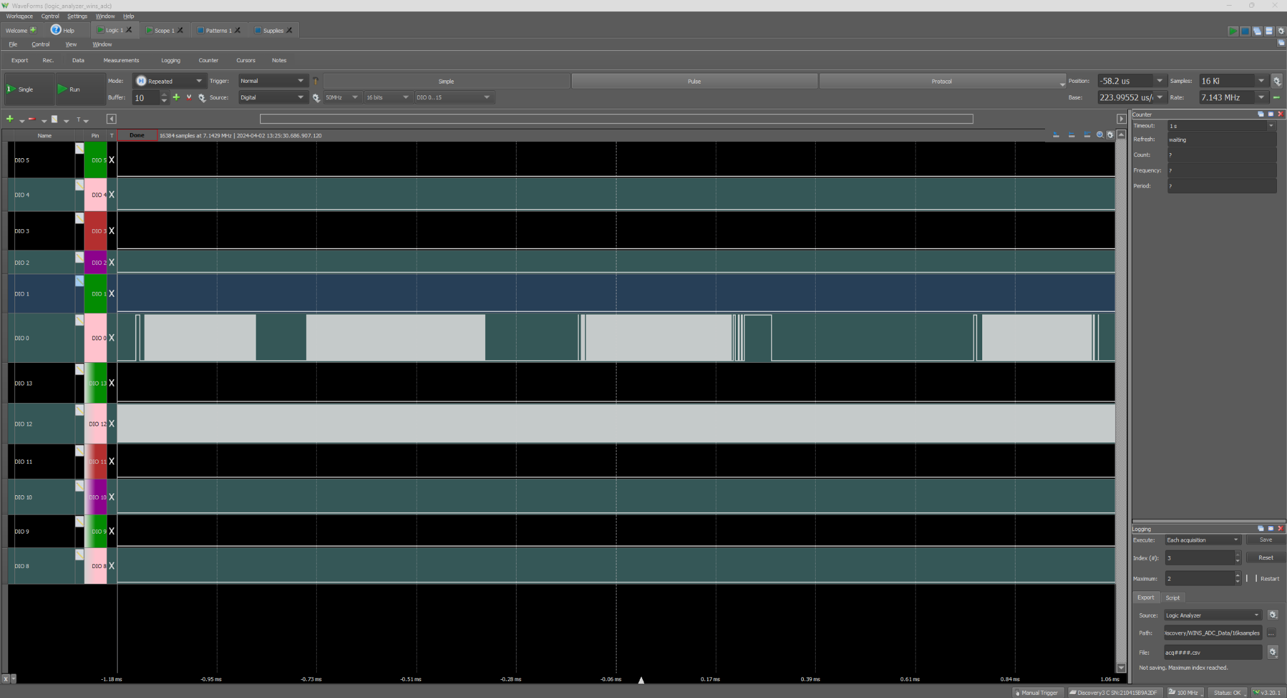
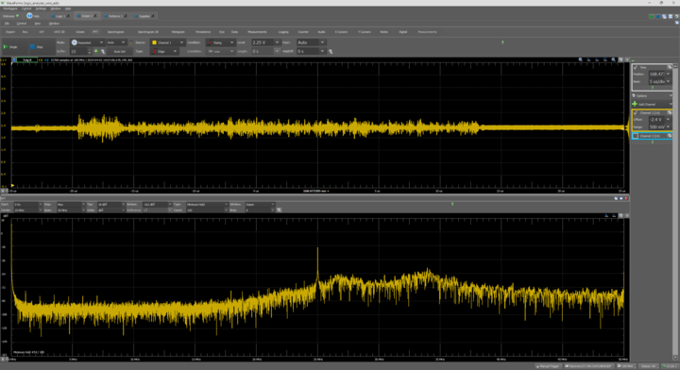
Initial Testing
PCB is functional!
Transmitting data over D0 (data output)

Slide 10
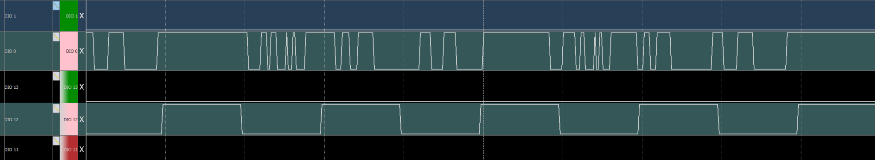
Testing
Top is data output
Bottom is clock signal
Top signal looks significantly faster than clock signal:
Uses SerDes technology to transmit data to the FPGA

Slide 11
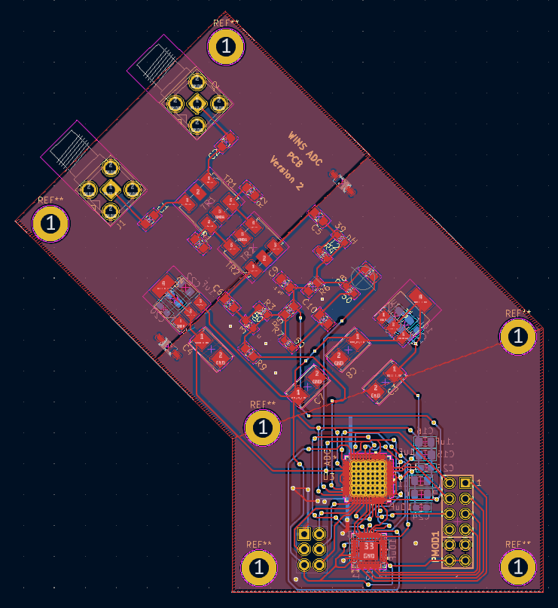
Next Steps
More intensive testing and data decoding
Implement changes discovered during testing
Switch out voltage regulator to one easier to solder
Change design to include standoffs
Figure out mounting system and integration

Slide 12
Acknowledgements
Thank you to:
Naomi Yescas
Mihailo Martinović
Ahmad Sabir Qureshi
Michelle Coe
And The Arizona Space Grant Consortium!

Slide 13
Thank You

Slide 14
References
Hrybyk-Keith, M. P. (2018, May 31). Ionosphere Graphics. NASA. https://svs.gsfc.nasa.gov/12960/#section_credits
NASA/JPL-Caltech/Montana State University. (2012, February 14). CubeSat artist rendering and NASA’s M-cubed/cove. NASA. https://www.jpl.nasa.gov/images/pia15380-cubesat-artist-rendering-and-nasas-m-cubedcove
Negrea, C., Zabotin, N., Bullett, T., Codrescu, M., & Fuller‐Rowell, T. (2016). Ionospheric response to tidal waves measured by dynasonde techniques. Journal of Geophysical Research: Space Physics, 121(1), 602–611. https://doi.org/10.1002/2015ja021574

Slide 15
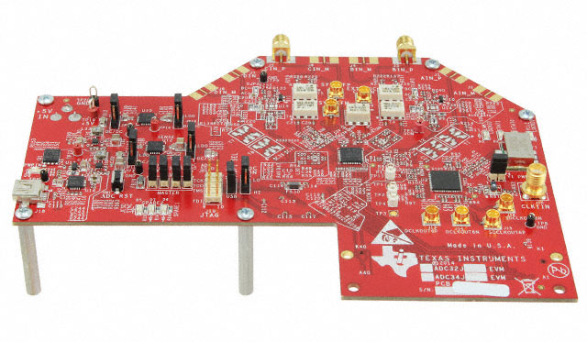
Hardware
ADC - ADC32J43
High-linearity
Ultra-low power
Dual Channel
14-bit
50-MSPS to 160-MSPS (mega samples per second)
One of the goals of the project is to apply legacy technology, so we took inspiration from the ADC32J43EVM

